Slide 1

§ 6.3 Multiplication & Division of Fractions
Review:
Multiplication of whole numbers means repeated addition.
This is also true for multiplying a whole number to a fraction.
e.g.
1
1
1
1
3
3
×
=
+
+
=
5
5
5
5
5
This shows that in general, we should have
a
k
×
a
k
×
=
b
b

Slide 2

Multiplication of Fractions
When we multiply a fraction to a fraction, the meaning is rather different because we cannot use repeated addition.
Definition:
means of
We are going to see several examples that can help you understand more.

Slide 3

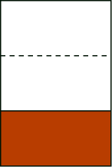
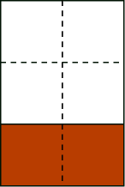
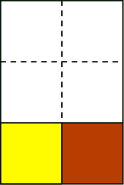
Example 1
Jordan got ¹⁄₃ of a chocolate bar from his sister. He ate ½ of it during lunch break and saved the rest for the evening. How much of a chocolate bar did he eat during lunch break?
Let us answer this question by drawing diagrams. (click)
the whole piece
of chocolate
¹⁄₃ of
the whole
½ of ¹⁄₃
From the last diagram, we see that the yellow piece he ate is equal to 1 out of 6 from the whole bar. Therefore ½ of ¹⁄₃ is ¹⁄_{6 .}

Slide 4
Example 1
Jordan got ¹⁄₃ of a chocolate bar from his sister. He ate ½ of it during lunch break and saved the rest for the evening. How much of a chocolate bar did he eat during lunch break?
Let us answer this question by drawing diagrams. (click)
the whole piece
of chocolate
¹⁄₃ of
the whole
½ of ¹⁄₃
From the last diagram, we see that the yellow piece he ate is equal to 1 out of 6 from the whole bar. Therefore ½ of ¹⁄₃ is ¹⁄_{6 .}

Slide 5
Example 1
Jordan got ¹⁄₃ of a chocolate bar from his sister. He ate ½ of it during lunch break and saved the rest for the evening. How much of a chocolate bar did he eat during lunch break?
Let us answer this question by drawing diagrams. (click)
the whole piece
of chocolate
¹⁄₃ of
the whole
½ of ¹⁄₃
From the last diagram, we see that the yellow piece he ate is equal to 1 out of 6 from the whole bar. Therefore ½ of ¹⁄₃ is ¹⁄_{6 .}

Slide 6
Example 1
Jordan got ¹⁄₃ of a chocolate bar from his sister. He ate ½ of it during lunch break and saved the rest for the evening. How much of a chocolate bar did he eat during lunch break?
Let us answer this question by drawing diagrams. (click)
the whole piece
of chocolate
¹⁄₃ of
the whole
½ of ¹⁄₃
From the last diagram, we see that the yellow piece he ate is equal to 1 out of 6 from the whole bar. Therefore ½ of ¹⁄₃ is ¹⁄_{6 .}

Slide 7
Example 1
Jordan got ¹⁄₃ of a chocolate bar from his sister. He ate ½ of it during lunch break and saved the rest for the evening. How much of a chocolate bar did he eat during lunch break?
Let us answer this question by drawing diagrams. (click)
the whole piece
of chocolate
¹⁄₃ of
the whole
½ of ¹⁄₃
From the last diagram, we see that the yellow piece he ate is equal to 1 out of 6 from the whole bar. Therefore ½ of ¹⁄₃ is ¹⁄_{6 .}

Slide 8
Example 1
Jordan got ¹⁄₃ of a chocolate bar from his sister. He ate ½ of it during lunch break and saved the rest for the evening. How much of a chocolate bar did he eat during lunch break?
Let us answer this question by drawing diagrams. (click)
the whole piece
of chocolate
¹⁄₃ of
the whole
½ of ¹⁄₃
From the last diagram, we see that the yellow piece he ate is equal to 1 out of 6 from the whole bar. Therefore ½ of ¹⁄₃ is ¹⁄_{6 .}

Slide 9
Example 1
Jordan got ¹⁄₃ of a chocolate bar from his sister. He ate ½ of it during lunch break and saved the rest for the evening. How much of a chocolate bar did he eat during lunch break?
Let us answer this question by drawing diagrams. (click)
the whole piece
of chocolate
¹⁄₃ of
the whole
½ of ¹⁄₃
From the last diagram, we see that the yellow piece he ate is equal to 1 out of 6 from the whole bar. Therefore ½ of ¹⁄₃ is ¹⁄_{6 .}

Slide 10
Example 1
Jordan got ¹⁄₃ of a chocolate bar from his sister. He ate ½ of it during lunch break and saved the rest for the evening. How much of a chocolate bar did he eat during lunch break?
Let us answer this question by drawing diagrams. (click)
the whole piece
of chocolate
¹⁄₃ of
the whole
½ of ¹⁄₃
From the last diagram, we see that the yellow piece he ate is equal to 1 out of 6 from the whole bar. Therefore ½ of ¹⁄₃ is ¹⁄_{6 .}

Slide 11
Let us answer this question by drawing diagrams.
the whole piece
of chocolate
¹⁄₃ of
the whole
½ of ¹⁄₃
From the last diagram, we see that the yellow piece he ate is equal to 1 out of 6 from the whole bar. Therefore ½ of ¹⁄₃ is ¹⁄_{6 .}
According to our definition, ½ of ¹⁄₃ is .
1
1
×
2
3
Hence
1
1
1
×
=
2
3
6

Slide 12
Multiplication of Fractions
Examples 2
On the other day, Jordan got ⁵⁄₈ of a chocolate bar from his mom and he gave ²⁄₃ of that to his younger brother.
How much of the original bar did he give away?
(click)
whole piece
of chocolate
⁵⁄₈ of the
whole
²⁄₃ of ⁵⁄₈

Slide 13
Multiplication of Fractions
In the diagram we see that the whole is cut into 3 columns and 8 rows, hence there should be
3 × 8 = 24 equal pieces in the whole.
The yellow portion has 2 columns and 5 rows, hence it has 2 × 5 = 10 such pieces.
²⁄₃ of ⁵⁄₈
This shows that the yellow portions takes up ¹⁰⁄₂₄ of the whole.
i.e.
2
5
2
×
5
10
×
=
=
3
8
3
×
8
24

Slide 14
Multiplication of Fractions
Conclusion:
Exercises:
1. Calculate
3
2
3
×
6
2
3
×
=
=
=
4
5
4
×
5
20
10
(after dividing top and bottom by 2)
4
×
2. Calculate
4
5
5
20
×
=
=
7
×
7
9
9
63
3. Calculate
5
×
×
5
5
6
6
5
2
10
×
=
×
=
=
=
6
9
1
9
×
×
9
1
3
1
3

Slide 15
Division of Fractions
Review: there are two approaches of division
Repeated subtraction: If there are 12 cookies and we want to take away 3 cookies at a time, how many times can we do this until there is none left?
Sharing approach: If there are 12 cookies, and we want to separate them into 3 equal groups, how many cookies will be in each group?
When we are dividing by whole numbers, both approaches work fine, but when we are dividing by fractions, the repeated subtraction approach will be more appropriate.

Slide 16
Why should 3 ÷ 8 be ³/₈ ?
Before we know the existence of fractions, the problem
3 ÷ 8 cannot be solved, and there will be a remainder of 3.
Now we can use fractions, what would be the appropriate answer to 3 ÷ 8 ?
Let’s consider the following example:
There are 3 cakes to be divided evenly among 8 people, how can this be done fairly and how much of a cake will each person get?

Slide 17

Solution:
The most logical way to do this is to cut each cake in to
8 equal pieces, and then 1 by 1 give out the pieces until every children has the same number of pieces.
(click to see animation)

Slide 18

Solution:
The most logical way to do this is to cut each cake in to 8 equal pieces, and then 1 by 1 give out the pieces until every children has the same number of pieces.

Slide 19
Solution:
The most logical way to do this is to cut each cake in to 8 equal pieces, and then 1 by 1 give out the pieces until every children has the same number of pieces.
In the end, each person will have 3 equal pieces, and since each piece is 1/8, the total amount each person will get is 3/8 .
Therefore the answer to 3 ÷ 8 should be 3/8 .

Slide 20
Conclusion:
For any non-zero whole numbers a and b, a ÷ b = ª⁄_{b} .
Exercises
1. What is 3 ÷ 4?
3
answer
:
4
6
2. What is 6 ÷ 5?
answer
:
5
3. What is 12 ÷ 9?
12
4
answer
:
=
9
3

Slide 21

Division of Fractions –
the Graphical Representation of Repeated Subtraction
$$5÷\frac{1}{2}$$
Example 1: Perform
Start with 5 wholes.
Divide each whole into halves (i.e. find a common denominator.)
Color 1/2 each time with different colors.
Count how many color used.

Slide 22
Division of Fractions –
the Graphical Representation of Repeated Subtraction
Start with 4 wholes.
Divide each whole into thirds (i.e. find a common denominator.)
Color 2/3 each time with different colors.
Count how many color used.

Slide 23
More on division by whole numbers
5 ÷ 3 = ?
c
5
3
unit
How many copies of the lime green rod is in the yellow rod?
c
c
c
The answer is 1 + 2/3, which equals to 5/3.
Hence 5 ÷ 3 is equal to 5/3.

Slide 24
More on division by whole numbers
9 ÷ 4 = ?
c
9
4
unit
How many copies of the magenta rod is in the blue rod?
c
c
c
c
The answer is 2 + 1/4, which equals to 9/4.
Hence 9 ÷ 4 is equal to 9/4.

Slide 25
Division of Fractions with a common denominator
What is equal to?
Solution:
¼
¼
¼
¼
¼
¼
¼
¼
¼
¼
¼
¼
¼
¼
¼
÷
¼
¼
¼
one group
We can see that there are 5 groups of ¾ in because
15 ÷ 3 = 5
This shows that when we divide fractions with the same denominator, we simply divide the numerators.
Alternatively, we can say that

Slide 26
Another Example
What is ?
Solution:
We use the fraction tiles again
This represents 9/8 because it has 9 copies of 1/8
This represents 3/8 because it has 3 copies of 1/8
Now our question becomes
“how many copies of are in ?”
(click to see animation)
The answer is 3 because

Slide 27
Another Example
What is ?
Solution:
÷
Answer:

Slide 28
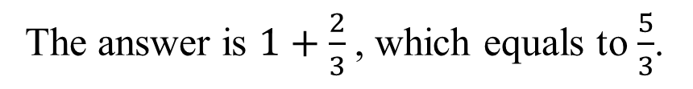
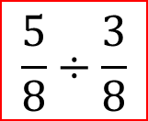
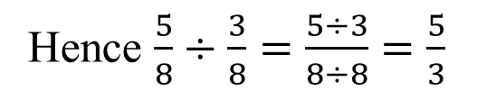
Division of Fractions with same Denominator
$$\frac{5}{8}÷\frac{3}{8}$$
unit
5/8
3/8
We picked brown as the unit because it represents 8.
How many copies of the lime green rod is in the yellow rod?
c
c
c
The answer is $1+\frac{2}{3}$, which equals to $\frac{5}{3}$.
Hence $\frac{5}{8}÷\frac{3}{8}=\frac{5÷3}{8÷8}=\frac{5}{3}$

Slide 29
Division of Fractions
Conclusion:
When we divide fractions with equal denominators, the denominators will be cancelled out and thus we can ignore the denominator and divide just the numerators,
i.e.

Slide 30
Division of Fractions
Exercises:
1. What is
10
5
10
÷
?
Ans
:
=
2
12
12
5
2. What is
16
7
16
2
÷
?
Ans
:
=
2
24
24
7
7
3. What is
13
4
13
1
÷
?
Ans
:
=
3
15
15
4
4

Slide 31
Division of Fractions with different denominators
Example:
How can we perform the division
Answer: Find a common denominator first!

Slide 32
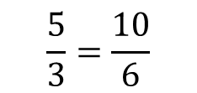
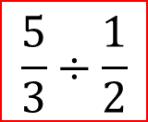
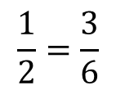
Division of Fractions with different Denominators
$$\frac{5}{3}÷\frac{1}{2}$$
We first find the lowest common denominator, which is 6. So we use the dark green rod as our unit (b/c it’s length is 6 white cubes).
Unit =
c
c
c
c
c
c
$$\frac{5}{3}=\frac{10}{6}$$
is represented by an orange rod b/c its length is 10 white cubes.
$$\frac{1}{2}=\frac{3}{6}$$
is represented by a lime green rod b/c its length is 3 white cubes.

Slide 33

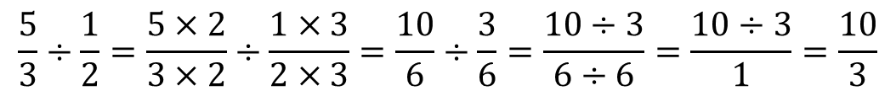
Division of Fractions with different Denominators
$$\frac{5}{3}÷\frac{1}{2}$$
How many copies of the lime green rod is in the orange rod?
c
c
c
The answer is $3+\frac{1}{3}$, which is equal to $\frac{10}{3}$.
The 10 comes from 5×2
This answer can be confirmed by algebra
$$\frac{5}{3}÷\frac{1}{2}=\frac{5×2}{3×2}÷\frac{1×3}{2×3}=\frac{10}{6}÷\frac{3}{6}=\frac{10÷3}{6÷6}=\frac{10÷3}{1}=\frac{10}{3}$$

Slide 34
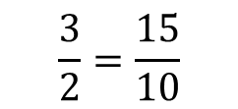
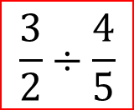
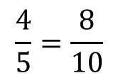
Division of Fractions with different Denominators
$$\frac{3}{2}÷\frac{4}{5}$$
We first find the lowest common denominator, which is 10. So we use the orange rod as our unit (b/c its length is 10 white cubes)
Unit =
c
c
c
c
c
c
c
c
c
c
$$\frac{3}{2}=\frac{15}{10}$$
is represented by an orange and a yellow rod
$$\frac{4}{5}=\frac{8}{10}$$
is represented by a brown rod

Slide 35

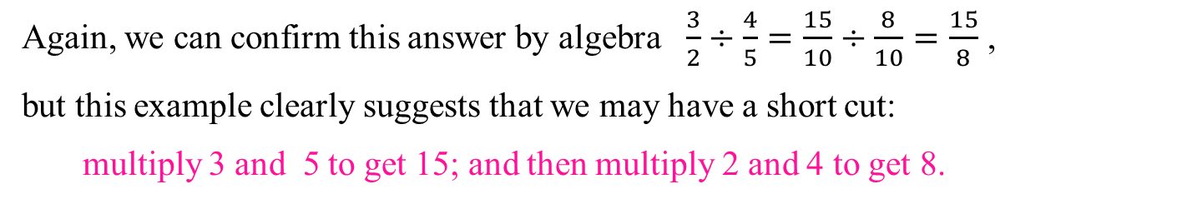
Division of Fractions with different Denominators
$$\frac{3}{2}÷\frac{4}{5}$$
How many copies of the brown rod is in the orange + yellow rods?
c
c
c
c
c
c
c
c
The answer is $1+\frac{7}{8}$ , which equals to $\frac{15}{8}$.
Again, we can confirm this answer by algebra $\frac{3}{2}÷\frac{4}{5}=\frac{15}{10}÷\frac{8}{10}=\frac{15}{8}$ ,
but this example clearly suggests that we may have a short cut:
multiply 3 and 5 to get 15; and then multiply 2 and 4 to get 8.

Slide 36
Example:
How can we perform the division
3
1
÷
?
4
5
The common denominator in this case is clearly 4 × 5 = 20.
1
1
×
3
3
×
4
4
i.e.
5
15
and
=
=
=
=
5
5
×
4
4
×
4
20
5
20
Therefore
3
1
15
4
15
÷
=
÷
=
15
÷
4
=
4
5
20
20
4

Slide 37
Another example:
How can we perform the division
7
2
÷
?
10
9
The common denominator in this case is clearly 10 × 9 = 90.
7
7
×
×
i.e.
9
63
2
2
10
20
=
=
and
=
=
10
10
×
×
9
90
9
9
10
90
Therefore
7
2
63
20
÷
=
÷
10
9
90
90
63
=
63
÷
20
=
20

Slide 38
Why do we multiply the reciprocal when dividing?
Let us look at this example
5
2
÷
9
7
The common denominator in this case is clearly 9 × 7 .
5
5
×
×
i.e.
7
2
2
9
=
and
=
9
9
×
×
7
7
7
9
5
2
5
×
×
Therefore
7
2
9
÷
=
÷
9
7
9
×
×
7
7
9
5
×
×
7
5
7
5
7
=
×
÷
×
=
=
=
×
(
5
7
)
(
2
9
)
2
×
×
9
9
2
9
2

Slide 39
The general (abstract) case
How can we perform the division
a
c
÷
?
b
d
The common denominator in this case is clearly b × d .
a
a
×
×
i.e.
d
c
c
b
=
and
=
b
b
×
×
d
d
d
b
a
c
a
×
×
Therefore
d
c
b
÷
=
÷
b
d
b
×
×
d
d
b
a
×
×
d
a
d
a
d
=
×
÷
×
=
=
=
×
(
a
d
)
(
c
b
)
c
×
×
b
b
c
b
c

Slide 40
Conclusion
When we divide fractions, we can multiply the dividend by
the reciprocal of the divisor.
a
c
a
d
÷
=
×
b
d
b
c

